Slide 1

Low code programming of interfaces for remotely controlled experiments
IPFN Science Summer Camp 2021 (ISSC)
Supervisor:
Dr.Prof. Horácio Fernandes
Authors:
José Veiga
Pedro Rosa

Slide 2
The Role of Remote Experiment
Sensors, arduino...
Experiment room
Internet
Protocol
29/09/2021
2
29/09/2021
IPFN Science Summer Camp 2021 (ISSC)
2

Slide 3
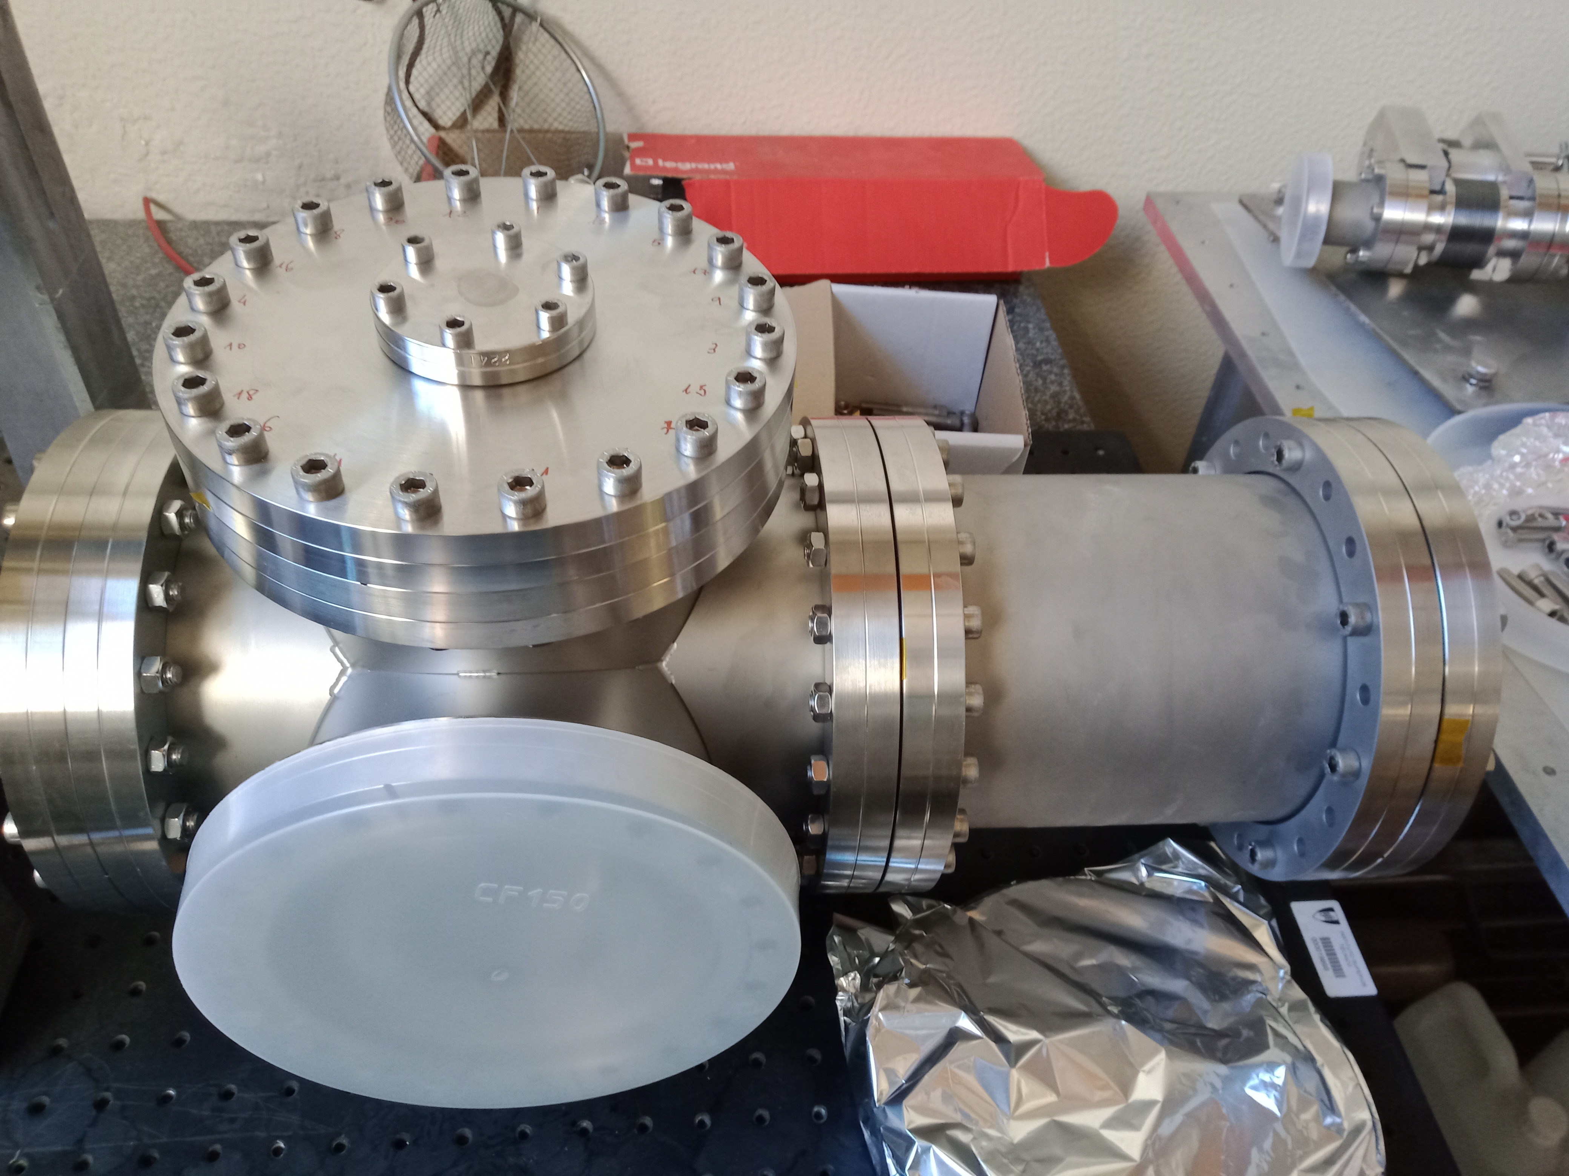
Using liquid metals as Plasma Facing
Facing Components in TOKAMAK
Main Requirements:
Tin (Sn) – Melting Point 232°C
Gallium (Ga) – Melting Point 29.8 °C
Temperature Sensors (600 °C)
29/09/2021
3
29/09/2021
IPFN Science Summer Camp 2021 (ISSC)
3

Slide 4
Requirements
Collecting Temperature data in the range of [25ºC, 600ºC];
Being able to control such an experiment.
29/09/2021
4
29/09/2021
IPFN Science Summer Camp 2021 (ISSC)
4

Slide 5
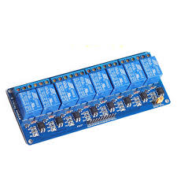
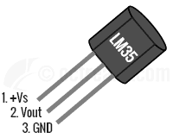
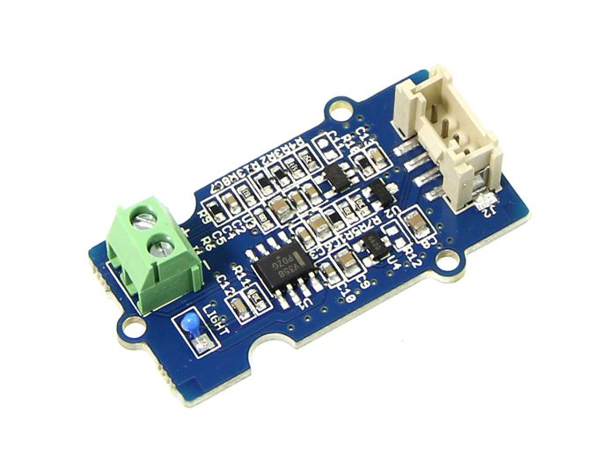
Hardware
Temperature Sensors:
LM35 [0, 100] ºC High Temp. [-125,600]ºC
Relay to control the system
29/09/2021
5
29/09/2021
IPFN Science Summer Camp 2021 (ISSC)
5

Slide 6
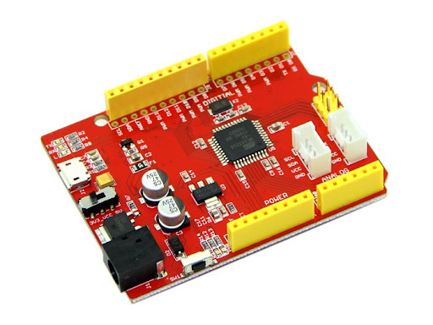
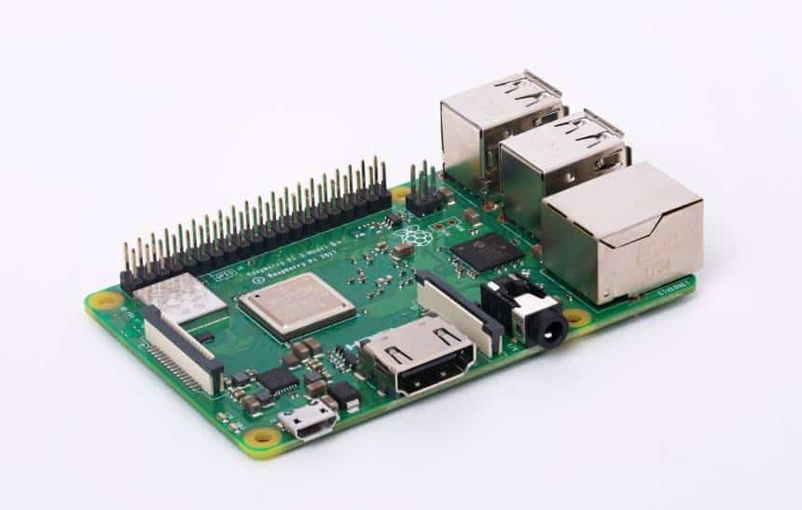
Hardware
Arduino
Raspberry pi
29/09/2021
6
29/09/2021
IPFN Science Summer Camp 2021 (ISSC)
6

Slide 7
Introduction
The problem:
Get the measurement of a sensor and display it in an application in order for the operator to evaluate the experiment evolution and control the valves responsible for the flow of liquid metal.
More requirements:
The user wants a interface that is not connected to the web;
He/She also wants a fast response of the digital output of the controller (Arduino).
And a way to store large quantity of data.
29/09/2021
7
29/09/2021
IPFN Science Summer Camp 2021 (ISSC)
7

Slide 8

First approach
ADC/I2C
Advantage of the architecture:
Serial Com
(BaudRate = 9600)
Can add more and different experiments;
Have all data in one server;
Can see the experiment and control it from anywhere in the world.
WebSockets
Pic
RPi_Server
Rest
Pic
Disadvantages of the architecture:
RPi_Server
The control can be delayed or never get to the experiment;
The main server needs a lot of processors and memory capacity to handle large numbers of experiments connected.
Uno
Flask
Main Server
RPi_Server
29/09/2021
8
29/09/2021
IPFN Science Summer Camp 2021 (ISSC)
8

Slide 9
Final system architecture
ADC/I2C
Serial Com
(BaudRate = 9600)
Rest
DataBase
(sqlite)
Uno
FastAPI
RPi_Server
29/09/2021
9
29/09/2021
IPFN Science Summer Camp 2021 (ISSC)
9

Slide 10
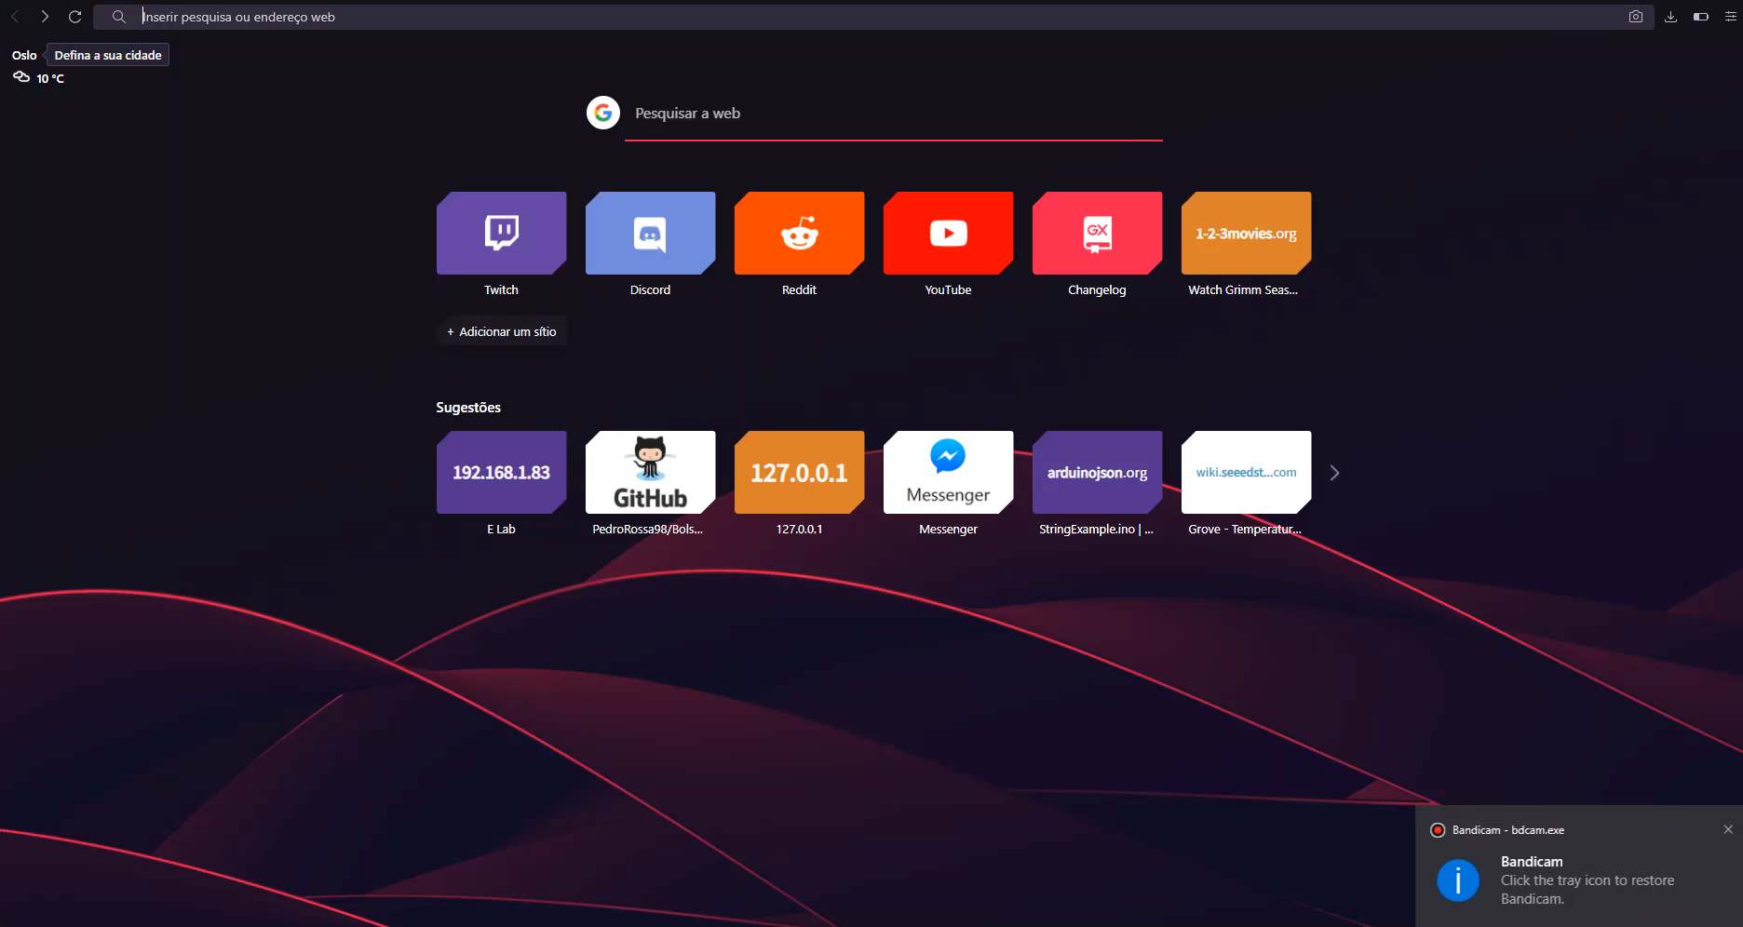
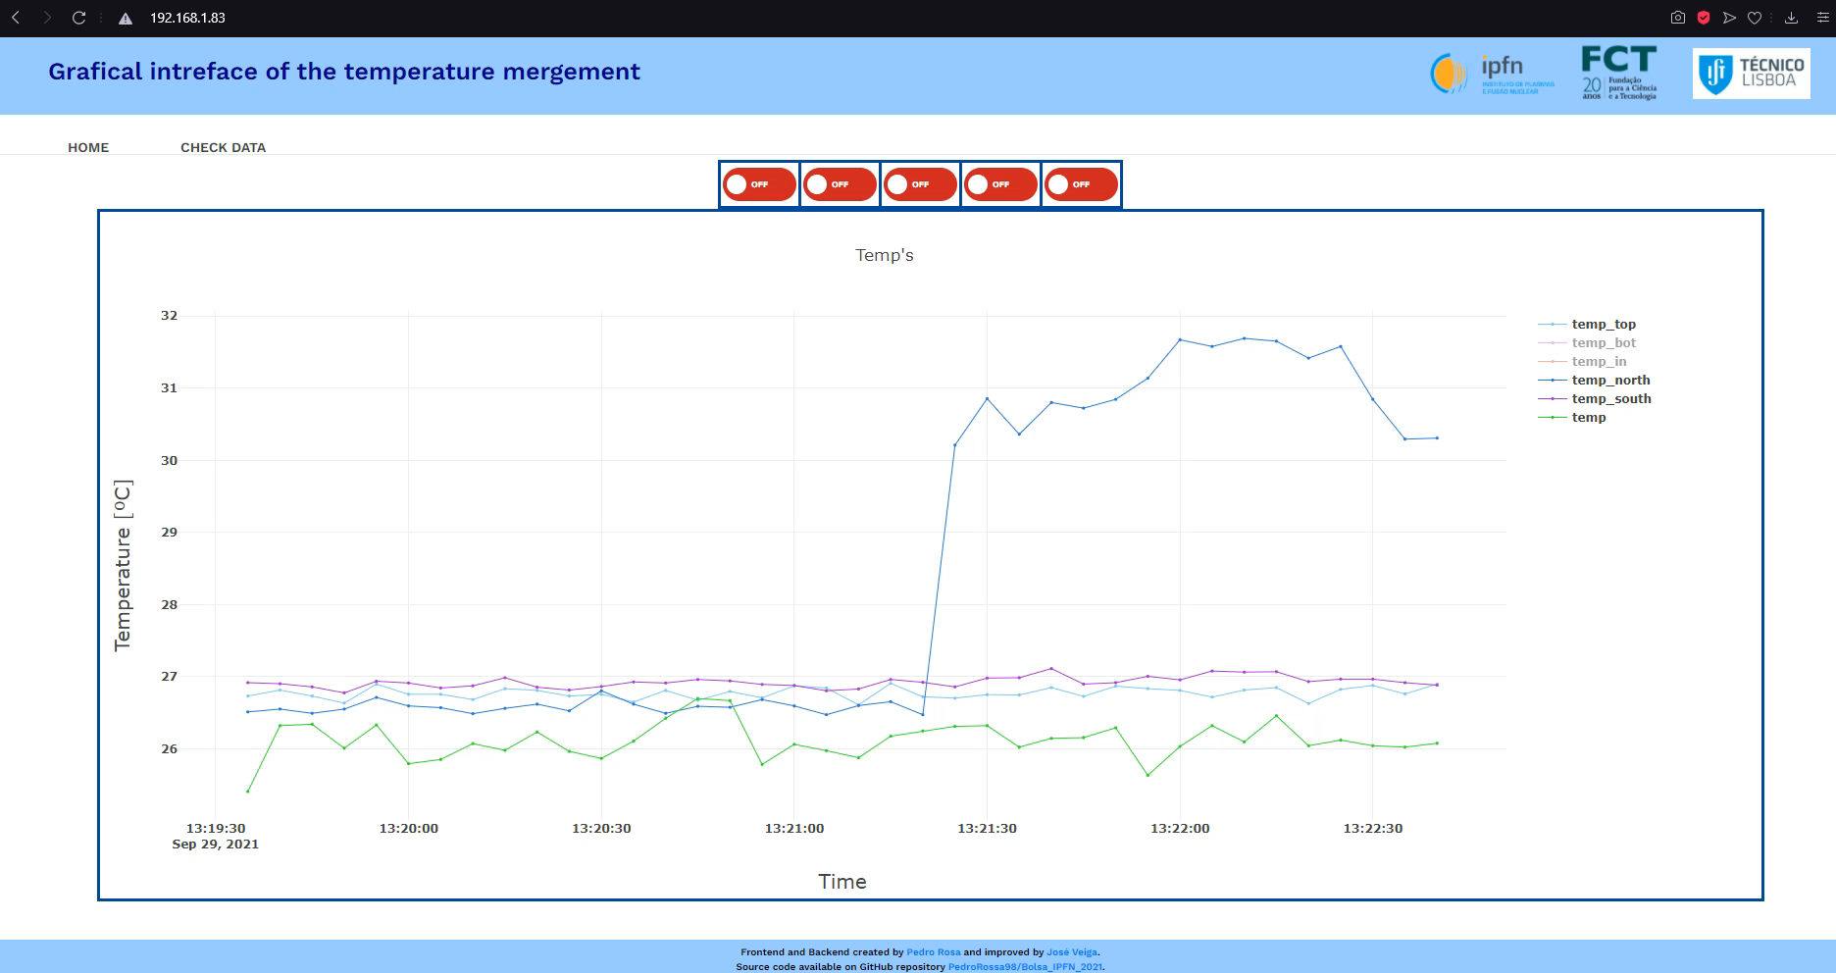
Conclusion
To improve:
Request fewer data and do more requests (10000 points*7);
Add a button to download the full database (csv);
Change the database from sqlite to something that can handle better the amount of data;
Add a yaxis range modifier in runtime.
29/09/2021
10
29/09/2021
IPFN Science Summer Camp 2021 (ISSC)
10

Slide 11




Sponsors
29/09/2021
IPFN Science Summer Camp 2021 (ISSC)
11

